Slide 1
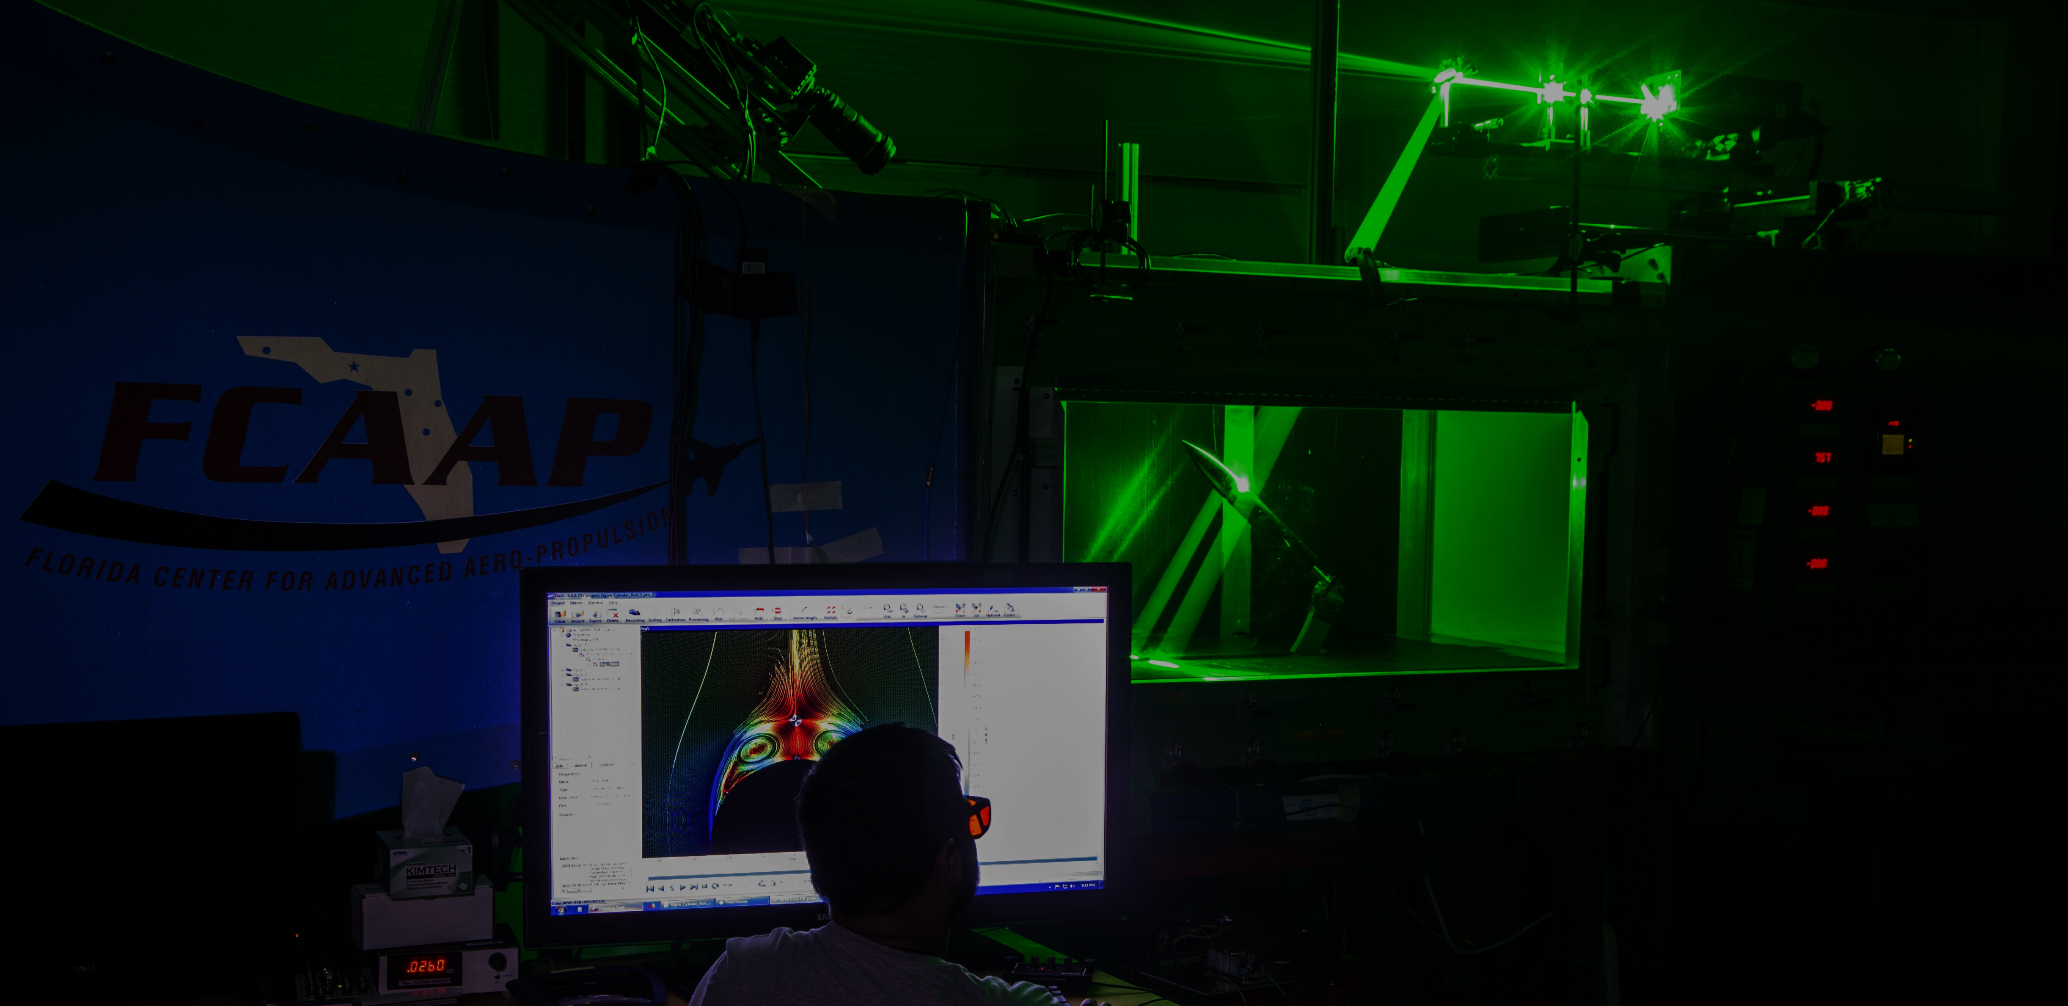
Smart Projectile
Jack Corbin | Prosley Dorcely | Emily Groth
Deepkumar Patel | Aaron Weingarten

Slide 2





Team 509
Jack Corbin
Prosley Dorcely
Emily Groth
Deepkumar Patel
Aaron Weingarten
Deepkumar Patel

Slide 3
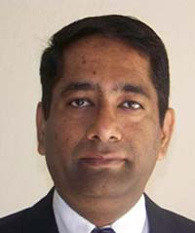
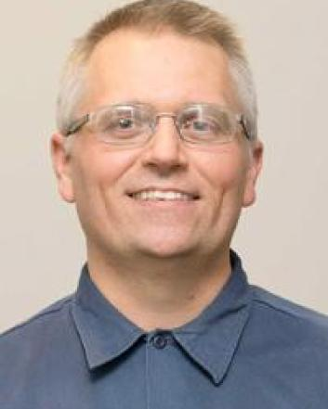


Sponsor and Advisor
Dr. Rajan Kumar
Sponsor
Dr. Jonas Gustavsson
Advisor
Robert Smith
Advisor
Deepkumar Patel

Slide 4
Objective
The objective of the project is to create a scale model of a projectile with an articulating nose cone and deflectable fins for subsonic wind tunnel testing.
Deepkumar Patel

Slide 5
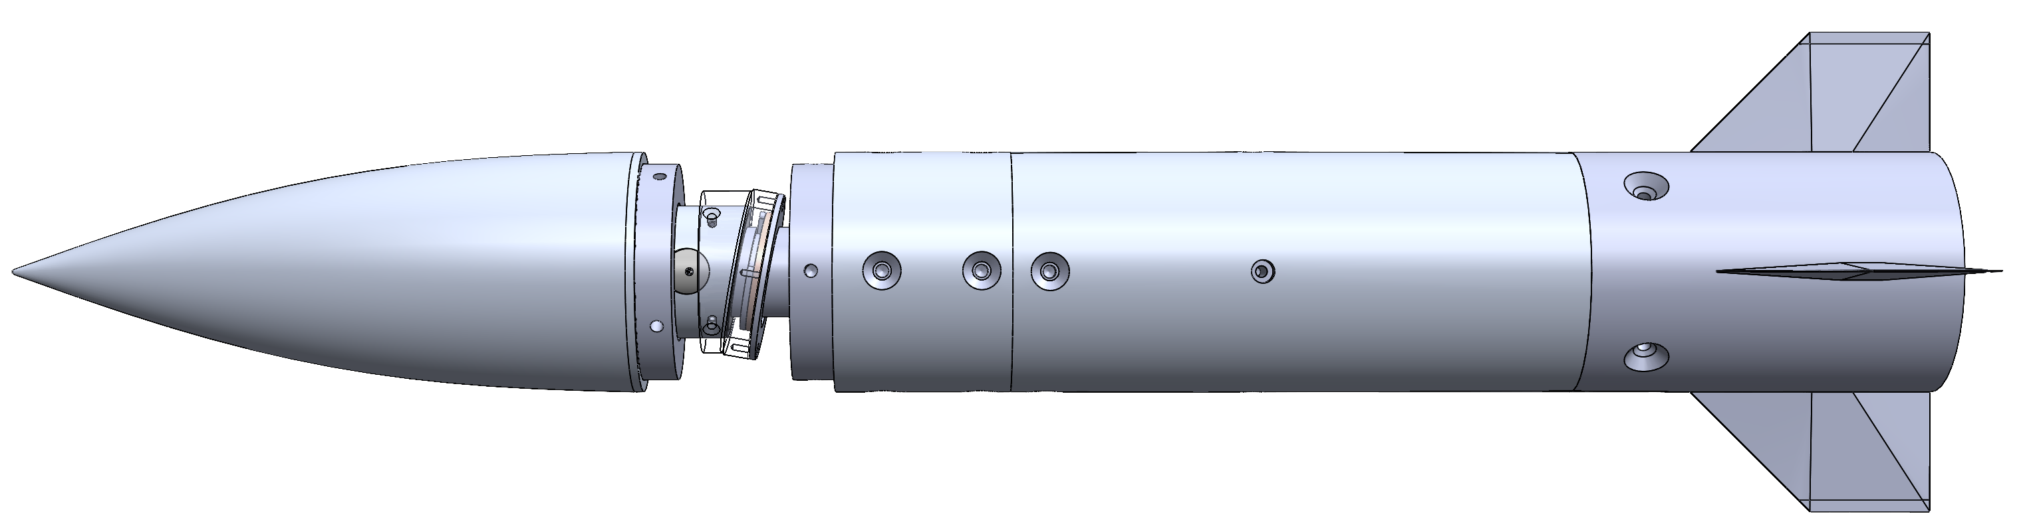
FCAAP Existing Model
Previous project just dealt with nose deflection.
Fins are not deflectable​
​
Excess current lead to overheating and reduced test time​
Excess weight caused sagging
Vibration from articulation mechanism​
Emily Groth

Slide 6
Critical Targets and Metrics
Nose deflection between 0 to 5 degrees with resolution ±0.1
Dynamic deflectable fins between 0 to 30 degrees
Time constant optimized to less than 0.5 seconds
θ
Emily Groth

Slide 7
Assumptions
Assumption 1
Assumption 2
Gravitational force will be far greater than the aerodynamic forces.
Assumption 3
No shockwaves will be produced (subsonic and incompressible)
Model has access to an outside power supply and controls.
Emily Groth

Slide 8
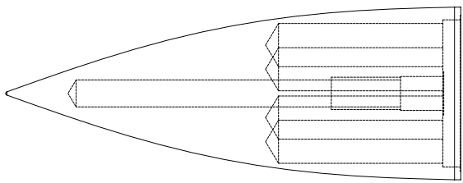
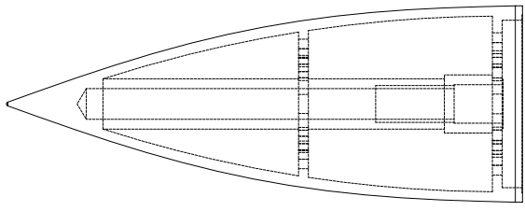
Nose Cone Light Weighting
Original Model:
Weight: 270g
Simple light weighting can be machined in house
Sintering Light Weight Model:
Weight: 148g
Complex geometries require a method of additive manufacturing
Emily Groth

Slide 9
Nose Cone Light Weighting
Lessons Learned:
Companies treat projects differently based on the customer
More material needs to be added for future parts
Material is acceptable for wind tunnel use
Emily Groth

Slide 10
Back Body Constraints
Inner diameter of outer body is 1.8 inches
Requirements:
5 grams or less
Under 0.65 in Diameter
Diameter of support shaft is 0.5 inches
Jack Corbin

Slide 11
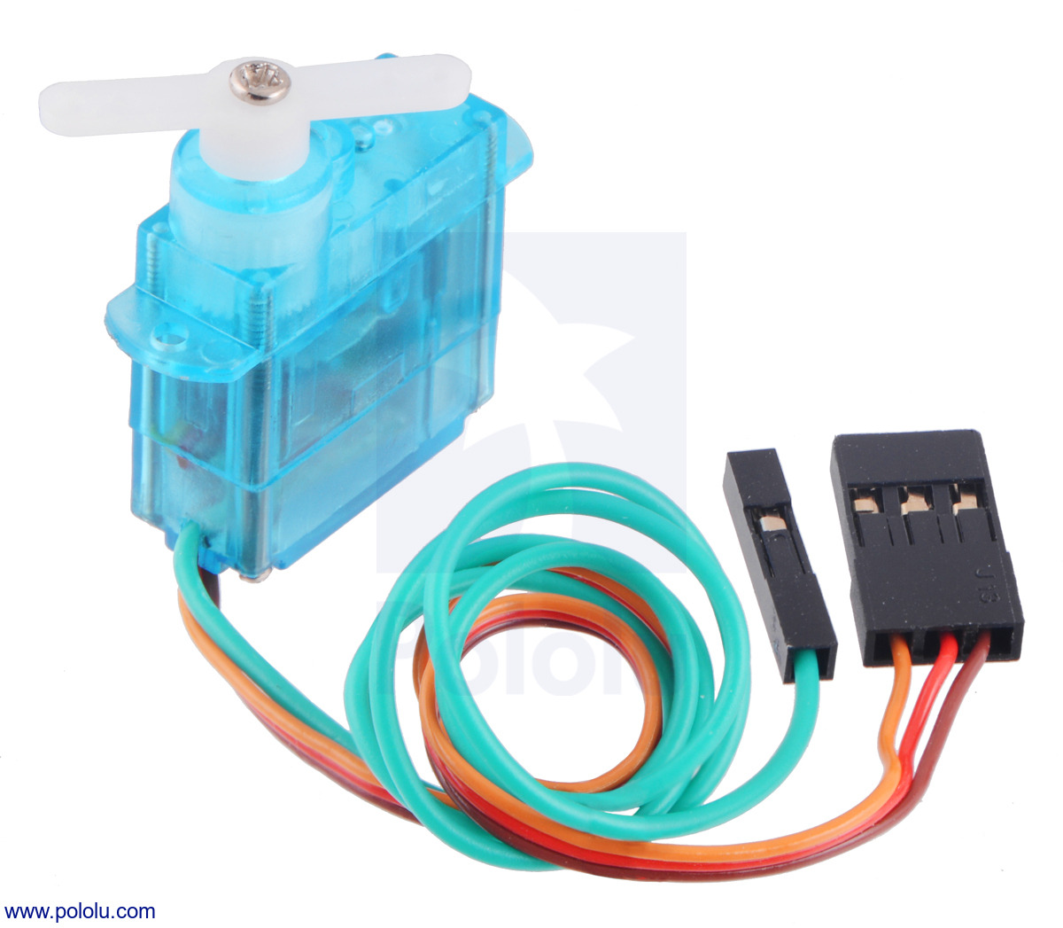
Motor Selection
FEETECH Sub-Micro Servo FS0403-FB
Specially modified to provide access to the feedback potentiometer to directly measure output position
Specs:
1.5 grams
0.79 x 0.76 x 0.33 in
Plastic Miter Gears
Steel Shaft
Jack Corbin

Slide 12
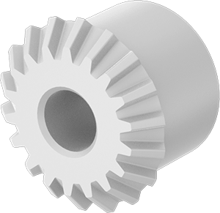
Gear Selection
FEETECH Sub-Micro Servo FS0403-FB
Specs:
18 teeth
Nylon plastic
Gear pitch: 48
Plastic Miter Gears
Steel Shaft
Jack Corbin

Slide 13
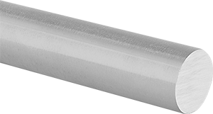
Shaft Selection
FEETECH Sub-Micro Servo FS0403-FB
Specs:
Multipurpose 304 Stainless Steel Rod
0.125" Diameter
Plastic Miter Gears
Steel Shaft
Jack Corbin

Slide 14
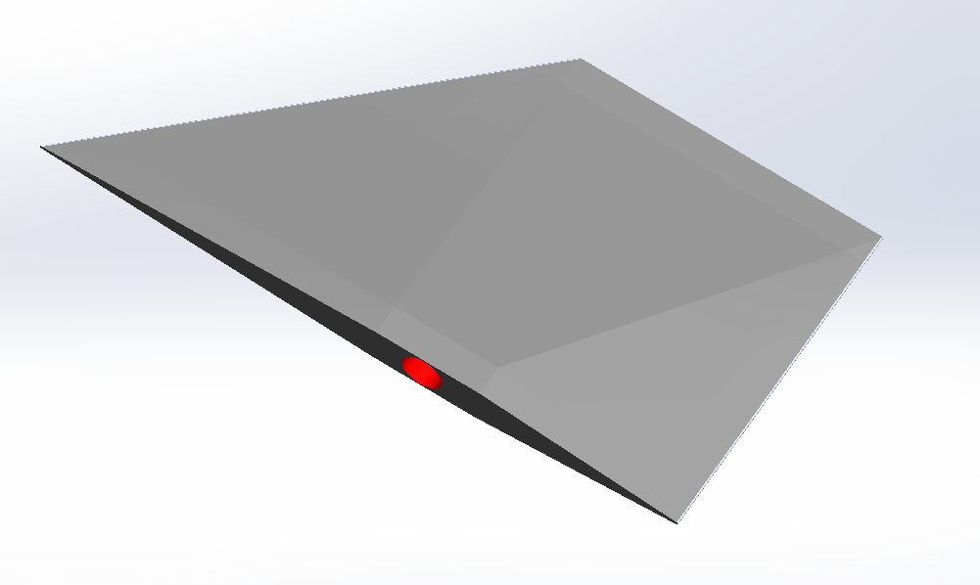
Fin Attachment
Fins
Hole is drilled
center of gravity
Attachment
Back Body
Jack Corbin

Slide 15
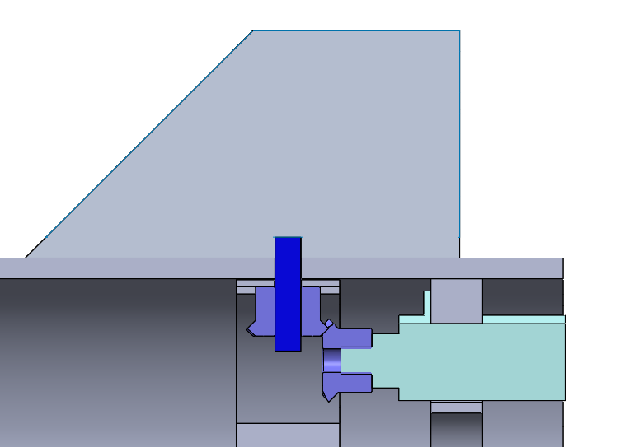
Gear Connections
Fins
Shaft connects gears to Servo motors
Attachment
Back Body
Jack Corbin

Slide 16
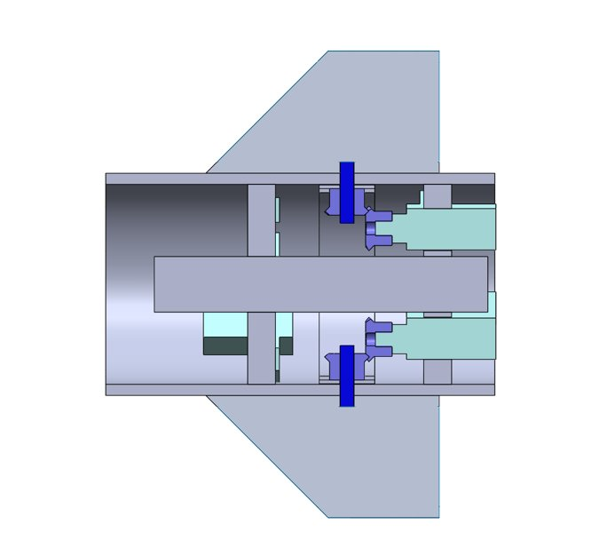
Fin Assembly
Fins
Cross section of top and bottom fin connection between the gears, shafts, and motors
Attachment
Back Body
Jack Corbin

Slide 17
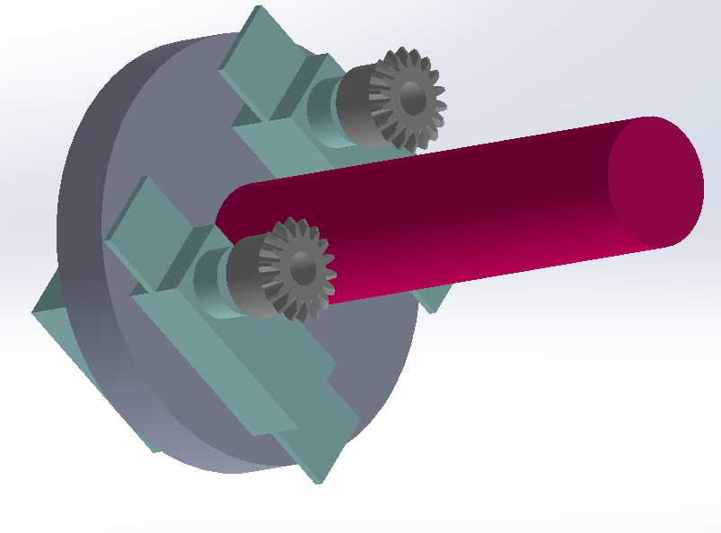
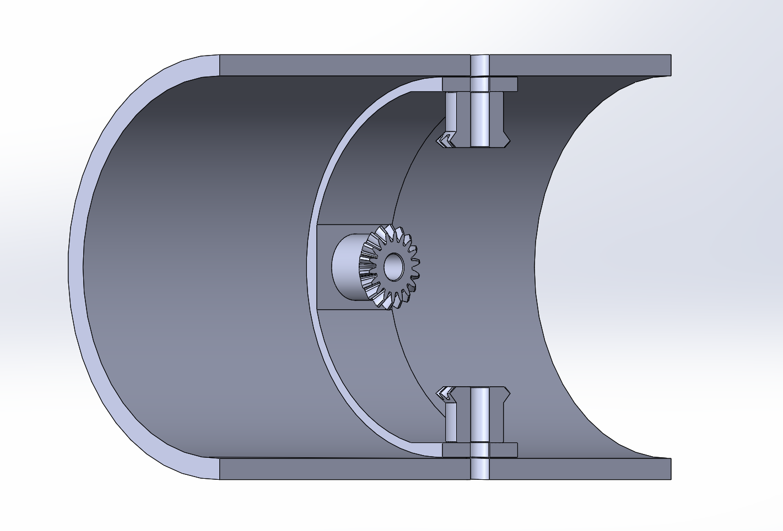
Housing Insert and Gear Support
Prosley Dorcely

Slide 18
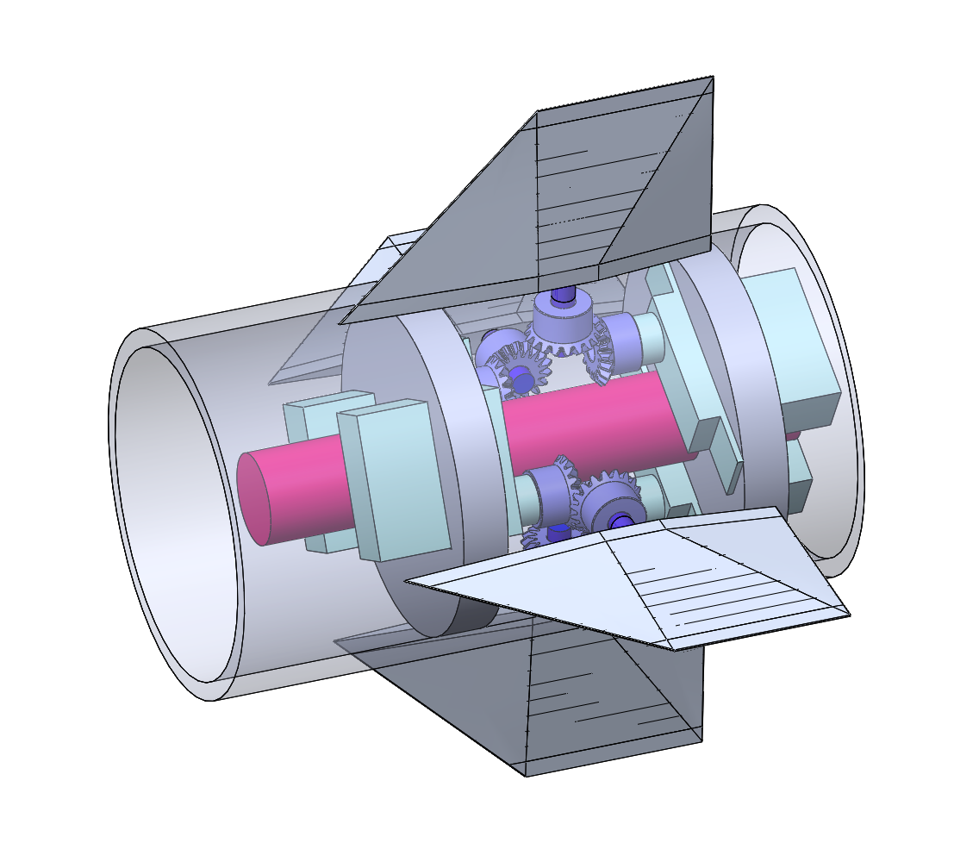
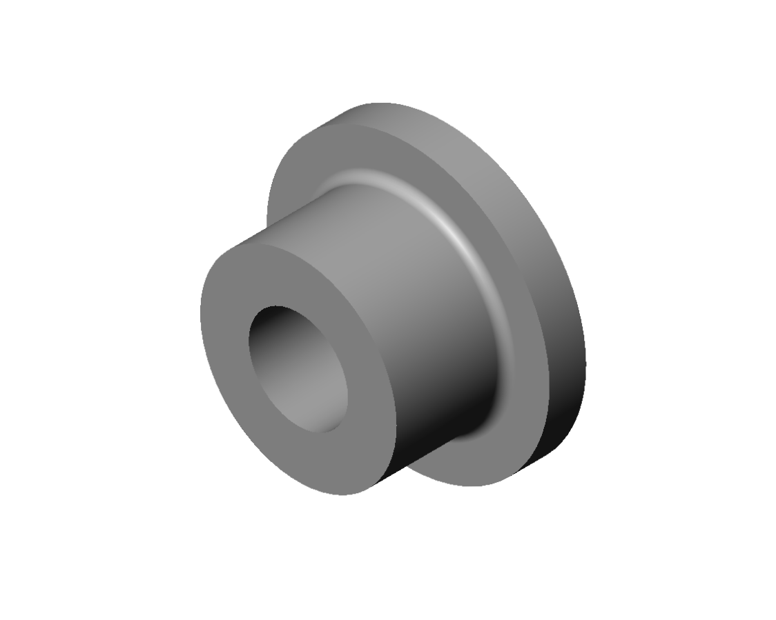
Back Body Design
Issues with the model:
1.Securing housing within body
2. Bearings
Prosley Dorcely

Slide 19
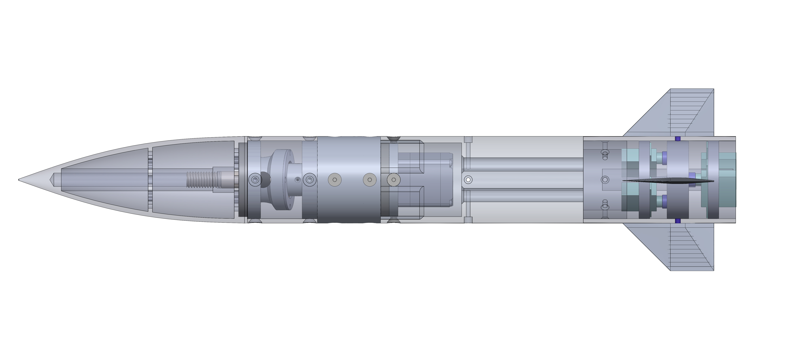
Final Design
Prosley Dorcely

Slide 20

Future Testing
Fin Testing
between 0 to 30
degrees with
resolution ± 0.1
Nose Testing
between 0 to 5 degrees with resolution ± 0.1
Time Testing
0.5 second
Deflection
θ
Aaron Weingarten

Slide 21
Budget
Item​ | Price​
6 FEETECH sub-micro servo FS0307​ | $39.00​
15 FEETECH sub-micro servo fs0403-fb with position feedback​ | $153.75
10 plastic miter gears​ | $79.90​
1 1/8-inch stainless steel rod (1 ft) | $1.92
Xometry​ for the Nose Cone | $1000.00​
8 Light Duty Dry-Running Flanged Sleeve Bearing | $38.24
Budget | $5000.00
Spent | $1312.81
Left | $3687.19
Aaron Weingarten

Slide 22



Incomplete Work
Machining of the fins
Machining of the back body
Assembly of the machined projectile parts
Back body wind tunnel test
Aaron Weingarten

Slide 23
Lessons Learned
  Ask more questions up front concerning the constraints of the project
  Identify the exact goal of the project from an earlier stage
  Avoid constraining the project too early
  Begin communication with the machinist at an earlier stage in the project to identify design flaws
  Prototype early to root out key design problems
Aaron Weingarten

Slide 24




Next Steps
Assembly
Final Testing
April
Senior Design Day
Celebration
Aaron Weingarten

Slide 25
Summary
Objective
  To create a scale model of a projectile with an articulating nose cone and deflectable fins for subsonic wind tunnel testing
Targets
  Nose Cone Deflection of up to 5 degrees
  Fin Deflection of up to 30 degrees
  Time Constant of 0.5 seconds
Design
  For the nose cone a stepper motor was implemented to control the deflection and for the fin deflection servo motors were used along with a gear train
Outcomes
  The nose cone was modified from last year's project to achieve a deflection of 5 degrees
  The fins haven't achieved deflectability yet
Incomplete Work
  We haven't been able to machine some necessary parts for the back body which hasn't allowed us to perform testing currently
Deepkumar Patel

Slide 26
Summary
Objective
  To create a scale model of a projectile with an articulating nose cone and deflectable fins for subsonic wind tunnel testing
Targets
  Nose Cone Deflection of up to 5 degrees
  Fin Deflection of up to 30 degrees
  Time Constant of 0.5 seconds
Design
  For the nose cone a stepper motor was implemented to control the deflection and for the fin deflection servo motors were used along with a gear train
Outcomes
  The nose cone was modified from last year's project to achieve a deflection of 5 degrees
  The fins haven't achieved deflectability yet
Incomplete Work
  We haven't been able to machine some necessary parts for the back body which hasn't allowed us to perform testing currently
Deepkumar Patel

Slide 27
Summary
Objective
  To create a scale model of a projectile with an articulating nose cone and deflectable fins for subsonic wind tunnel testing
Targets
  Nose Cone Deflection of up to 5 degrees
  Fin Deflection of up to 30 degrees
  Time Constant of 0.5 seconds
Design
  For the nose cone a stepper motor was implemented to control the deflection and for the fin deflection servo motors were used along with a gear train
Outcomes
  The nose cone was modified from last year's project to achieve a deflection of 5 degrees
  The fins haven't achieved deflectability yet
Incomplete Work
  We haven't been able to machine some necessary parts for the back body which hasn't allowed us to perform testing currently
Deepkumar Patel

Slide 28
Summary
Objective
  To create a scale model of a projectile with an articulating nose cone and deflectable fins for subsonic wind tunnel testing
Targets
  Nose Cone Deflection of up to 5 degrees
  Fin Deflection of up to 30 degrees
  Time Constant of 0.5 seconds
Design
  For the nose cone a stepper motor was implemented to control the deflection and for the fin deflection servo motors were used along with a gear train
Outcomes
  The nose cone was modified from last year's project to achieve a deflection of 5 degrees
  The fins haven't achieved deflectability yet
Incomplete Work
  We haven't been able to machine some necessary parts for the back body which hasn't allowed us to perform testing currently
Deepkumar Patel

Slide 29
Summary
Objective
  To create a scale model of a projectile with an articulating nose cone and deflectable fins for subsonic wind tunnel testing
Targets
  Nose Cone Deflection of up to 5 degrees
  Fin Deflection of up to 30 degrees
  Time Constant of 0.5 seconds
Design
  For the nose cone a stepper motor was implemented to control the deflection and for the fin deflection servo motors were used along with a gear train
Outcomes
  The nose cone was modified from last year's project to achieve a deflection of 5 degrees
  The fins haven't achieved deflectability yet
Incomplete Work
  We haven't been able to machine some necessary parts for the back body which hasn't allowed us to perform testing currently
Deepkumar Patel

Slide 30
Thanks for listening
Jack
Corbin
Deepkumar Patel
Emily
Groth
Prosley Dorcely
Aaron
Weingarten
Deepkumar Patel

Slide 31
Concept Selection
Concept | Alternative Value
Smart projectile has an interior pulley system that deflects the nose cone to alter flight path | 0.258482
Smart projectile uses articulating nose cone and dynamically deflectable fins for flight control | 0.47494
Smart projectile uses thrust vectoring nozzles to articulate the nose cone to a desired deflection | 0.266536
Emily Groth

Slide 32
Markets and Stakeholders
FCAAP
Air Force
Boeing
Raytheon
Lockheed Martin
General Dynamics
College of Engineering
Dr. Jonas Gustavsson
Dr. Rajan Kumar
Dr. Shayne McConomy
Dr. Suvranu De
Emily Groth

Slide 33
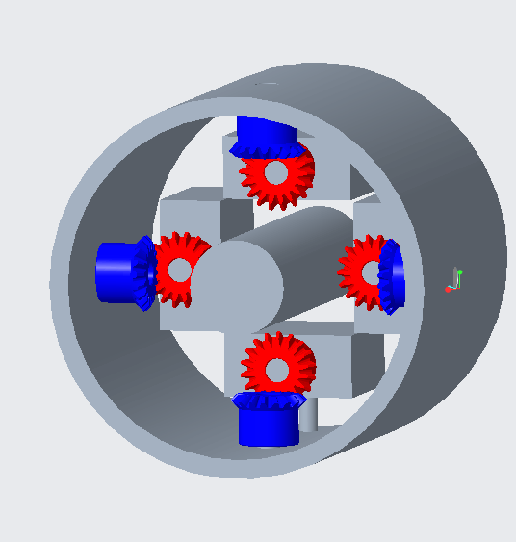
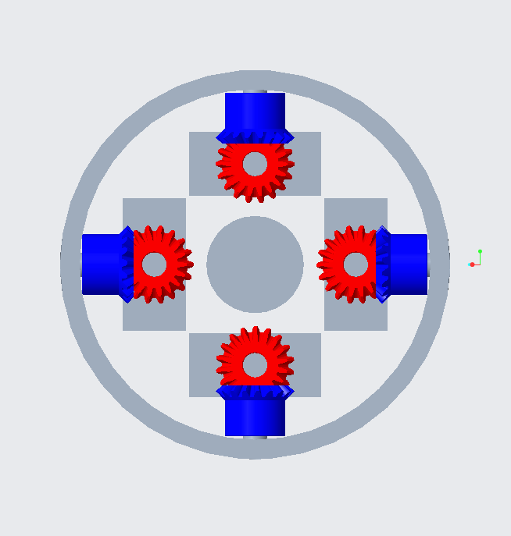
Motor Configuration
CAD model for the motors and gears configuration
Angled View
Back View
Prosley Dorcely

Slide 34
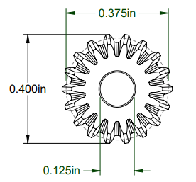
Gear Selection (Clean up make more presentable)
Plastic Miter Gears
18 teeth
Nylon plastic
Gear pitch: 48
Jack Corbin

Slide 35
Fin Attachment
Method 1
Weld a large short shaft to end of fin
Brittle connection
Possible manufacturing problem when cleaning up connection surface
Method 2
Drill hole in each fin and insert a smaller shaft inside
Might be weaker and compromise the fin
Shaft would fail from bending
Jack Corbin

Slide 36
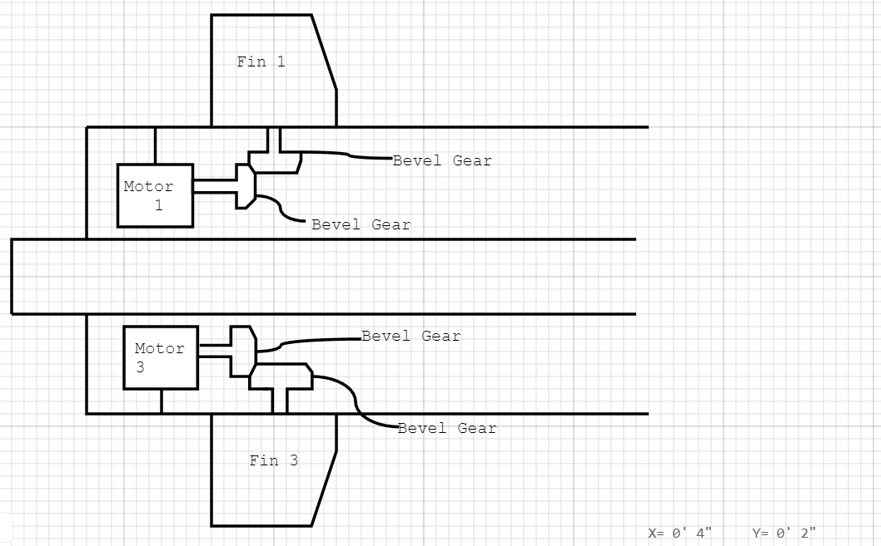
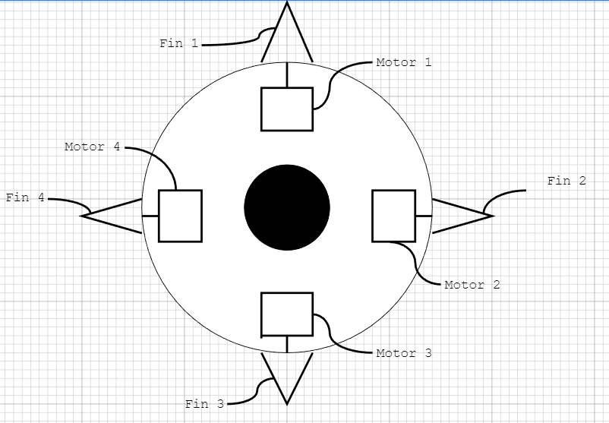
Back Body Configuration
Right Side View
Back View
Prosley Dorcely
Prosley Dorcely

Slide 37
Motor Selection
FEETECH Sub-Micro Servo FS0403-FB
Specially modified to provide access to the feedback potentiometer through a fourth (green) wire, allowing you to directly measure the position of the output.
Specs:
5 Grams
0.79 x 0.76 x 0.33 in
Positional Feed back
Jack Corbin

Slide 38
Medium Fidelity Concepts
Concept # | Concept Description
3 | An interior pulley system that deflects the nose cone to alter flight path
23 | Multi-shape fin which can be altered to allow it to find the target and change flight path
59 | Uses an internal mass for mechanical control to alter flight path
69 | Morphing fins that can widen and thin out depending on the forces they are trying to exert
83 | Thrust vectoring nozzles to articulate the nose cone to a desired deflection
Deepkumar Patel

Slide 39
High Fidelity Concepts
Concept # | Concept Description
27 | Smart projectile uses deflectable thrusters to change flight path
34 | Smart projectile uses articulating nose cone and dynamically deflectable fins for flight control
53 | Smart projectile rapidly ejects and retracts internal mass to change flight path
Deepkumar Patel

Slide 40
Parts that are re-machined
Back fin body
Fins
Prosley Dorcely

Slide 41
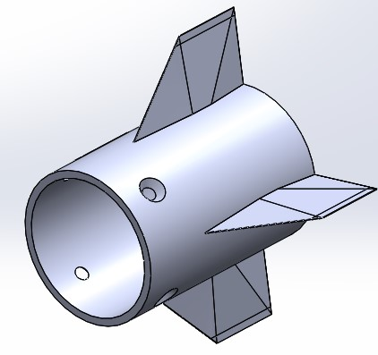
Fin Deflection
Implement four small motors to control each individual fin
Lack of space in the rear portion of the model
Need to find motors that are small enough to fit in body and have high precision
Aaron Weingarten

Slide 42
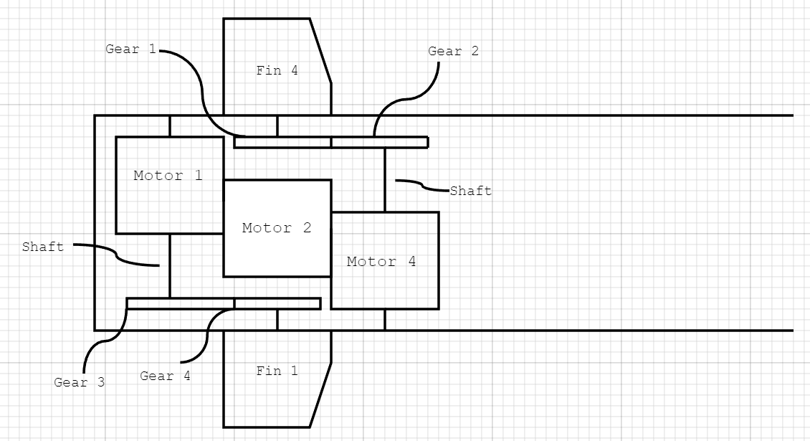
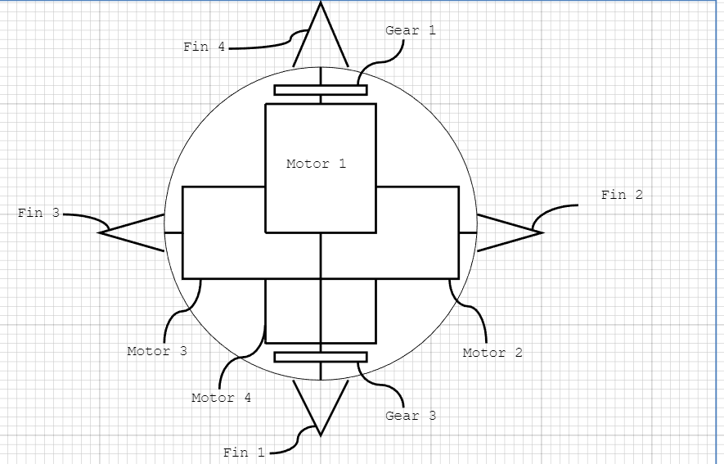
Fin Motor Configuration 1 (Update with new CAD)
Right Side View
Back View
Prosley Dorcely

Slide 43
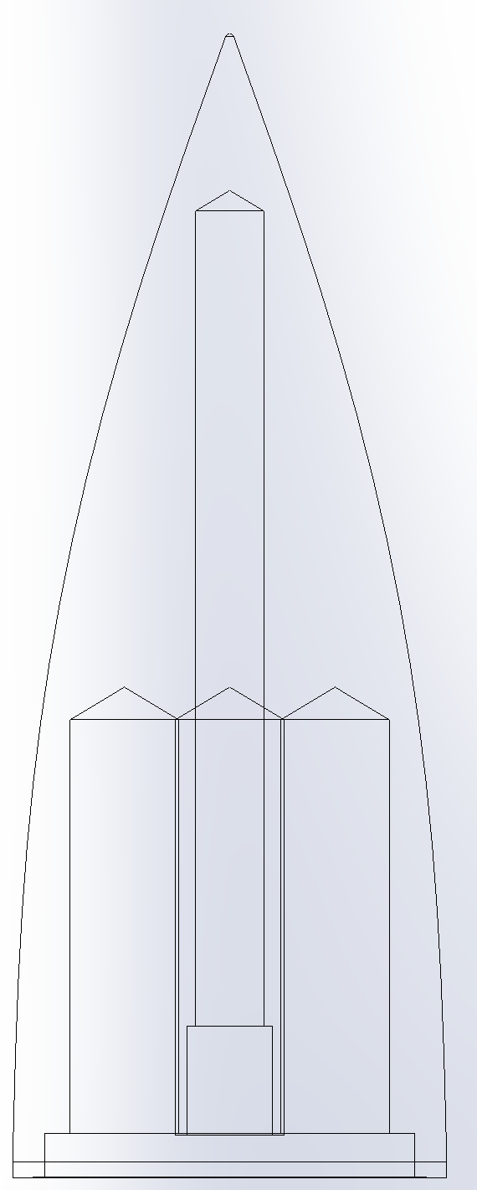
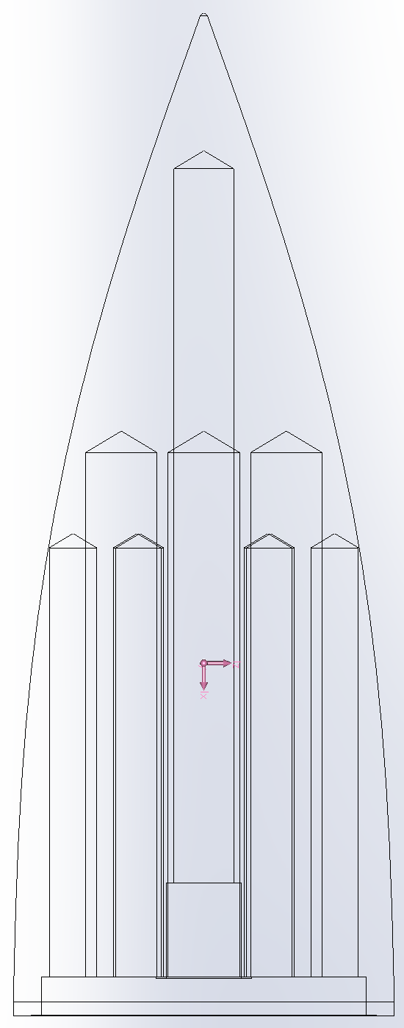
Nose Cone Light Weighting (Update on Sintering?)
Original Model:
Weight: 270g
Simple light weighting can be machined in house
Alternative Drilling Model:
Weight: 260g
Small weight reduction not worth extra complexity
Emily Groth

Slide 44
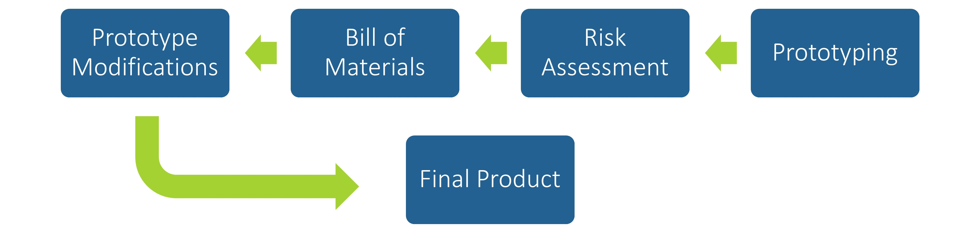
Future Work
Prosley Dorcely

Slide 45
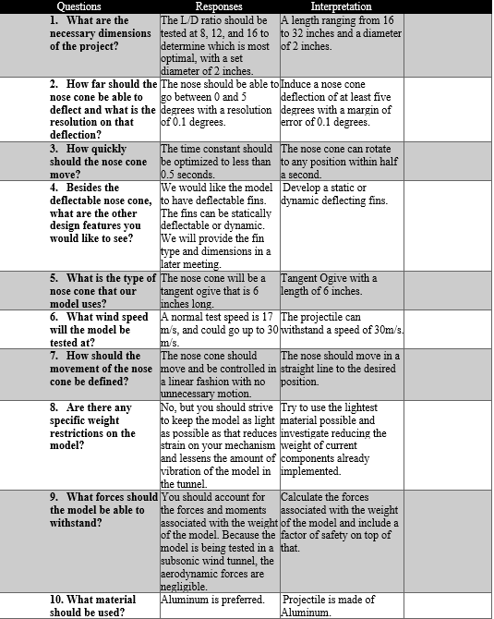
Customer Needs Backup

Slide 46
Markets Backup
Primary Market
  FCAAP (Florida Center for Advanced Aero Propulsion)
Secondary Markets
  Air Force Office of Scientific Research (AFOSR)
  Air Force Research Laboratory (AFRL)
  Lockheed Martin
  General Dynamics
  Raytheon Technologies
  Boeing
  Northrop Grumman

Slide 47
Stakeholders Backup
Florida Center for Advanced Aero Propulsion
FAMU-FSU College of Engineering
Dr. Rajan Kumar
Dr. Jonas Gustavsson
Dr. Shayne McConomy
Dr. Suvranu De

Slide 48
Standard Shapes
Summary Box
Text box 1
Outlined Text Box

Slide 49




Approved Logos

Slide 50
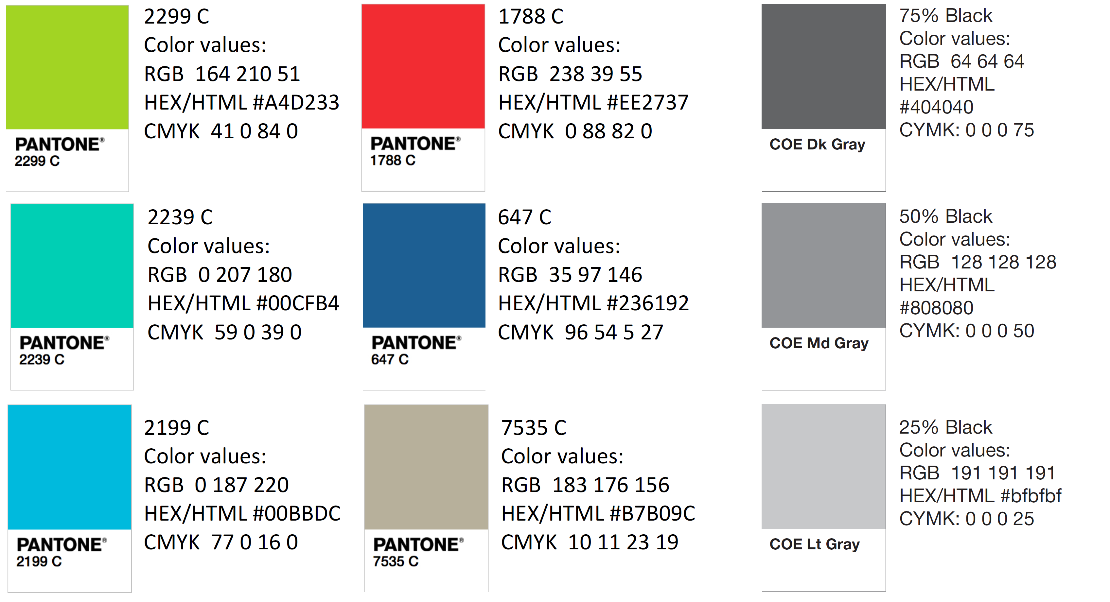
Color Palette

Slide 51
APA Tables
Category 1 | Category 2 | Category 3 | Category 4 | Category 5
Item 1
Item 2
Item 3
Item 4
 | Category 2 |  |  | Category 3
Category 1 | subcategory 1 | subcategory 2 |  | subcategory 1 | subcategory 2
Item 1
Item 2
Item 3
Item 4

